Slide 1
PyMOL 2.0
23/11/2017
Adva Yeheskel
Bioinformatics Unit, Life Science Faculty, TAU

Slide 2
Downloading PyMOL 2.0
Download from here: https://pymol.org/2/
Open the downloaded file and install it
Get the academic licence here: https://pymol.org/edu/?q=educational
Enter the link in the received email and download the licence file
Browse the licence file from Pymol (after installing)

Slide 3
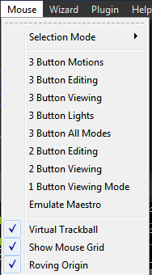
Mouse operations
Default:
Left click- rotating
Right click- zooming
Middle click- translating
Middle scroll- clipping

Slide 4
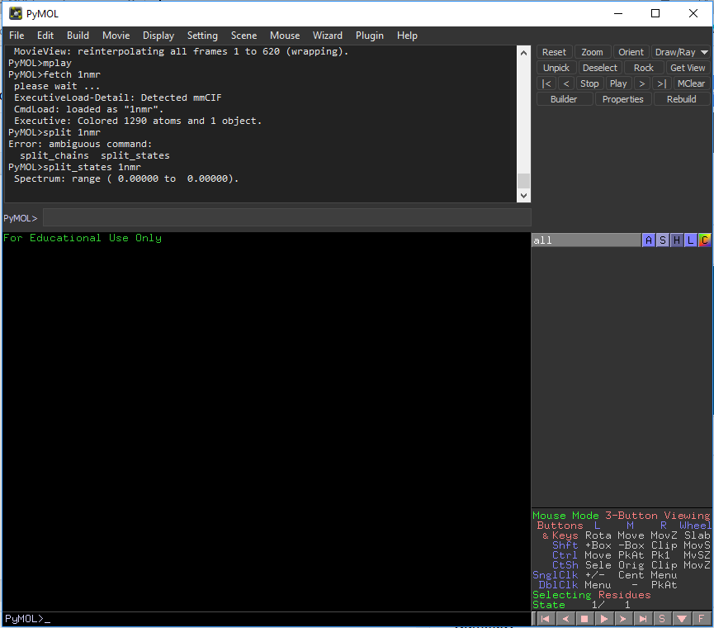
Menus
External control
Graphical menu
Text commands
Movie control

Slide 5
Uploading a PDB file
Browse the PDB website and download a PDB file
File -> Open
File -> Get PDB
Command line: fetch PDB-ID

Slide 6
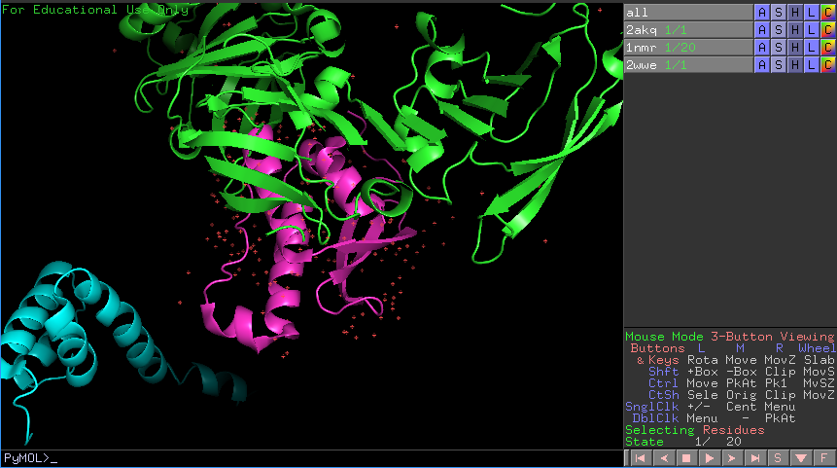
Graphical menu : for each molecule
1. Show / hide specific molecules
2. What is “sele”
Make sure to act on the wanted molecule.

Slide 7
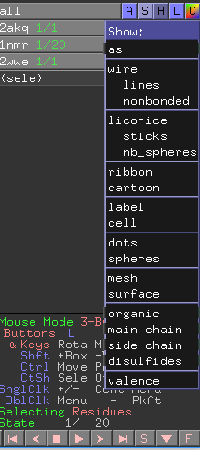
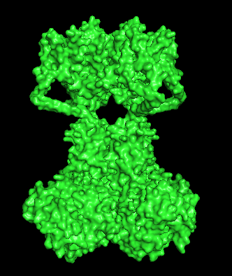
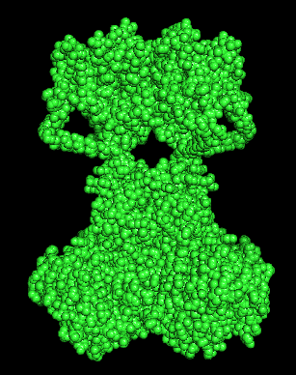
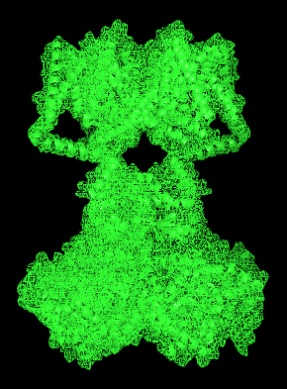
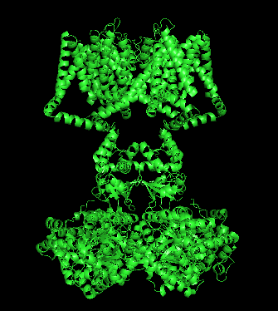
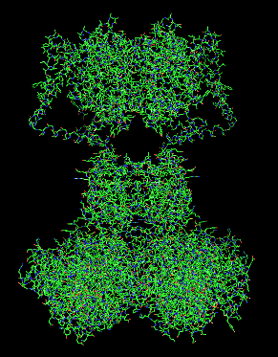
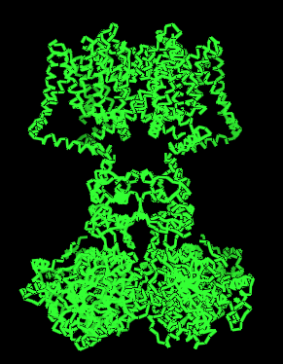
Representations (S=show)
surface
spheres
mesh
mesh+cartoon
cartoon
wire
ribbon

Slide 8
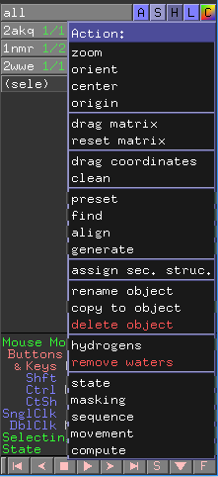
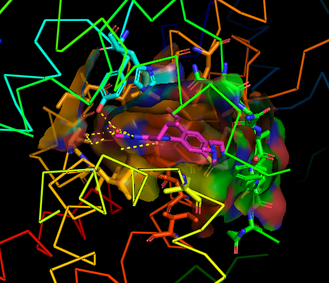
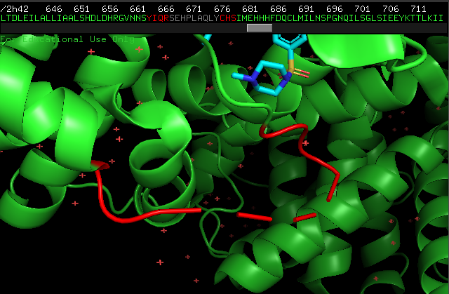
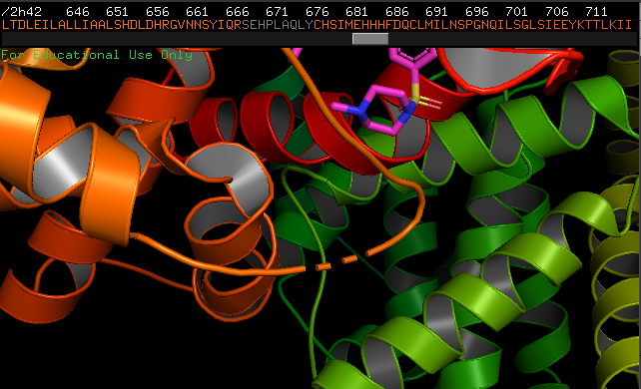
Actions (A)
preset-> ligand_sites-> transparent surface
Missing residues in the red loop
preset-> publication

Slide 9
Hide (H)

Slide 10
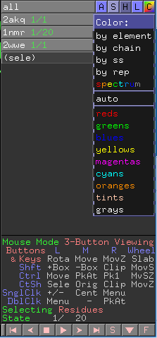
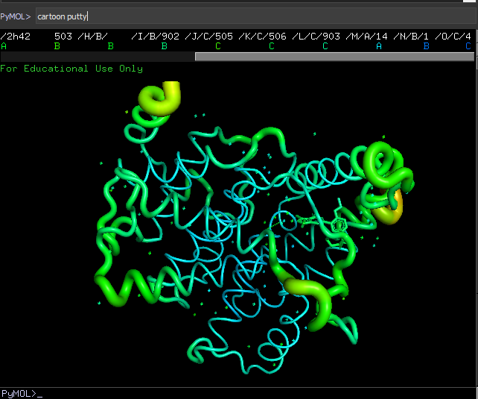
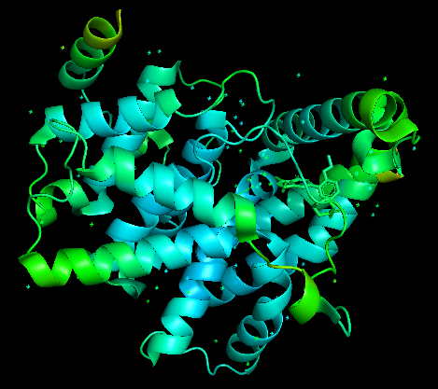
Color (C)
By ss : secondary structure (helix, beta and loop is different colors)
By rep: representation (after showing different representations you can color each in a different color, i.e. cartoons in blue, sticks in yellow…)
Spectrum: rainbow by sequence.
Spectrum: b-factors (applies only for x-ray structures)
cartoon putty

Slide 11
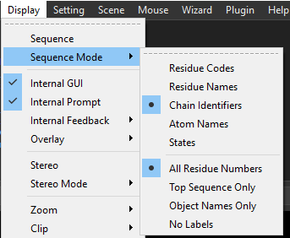
Show sequence
Click on S at the bottom (movie control)
Display -> sequence
Display-> sequence mode

Slide 12
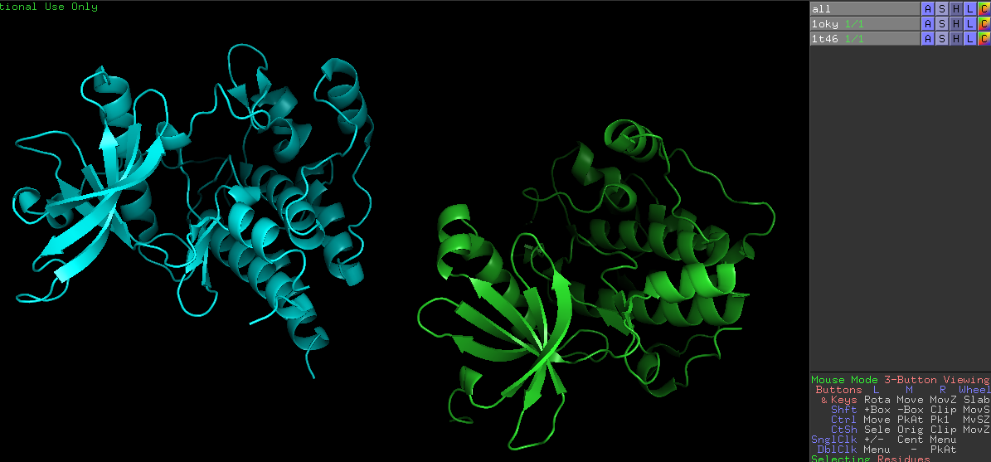
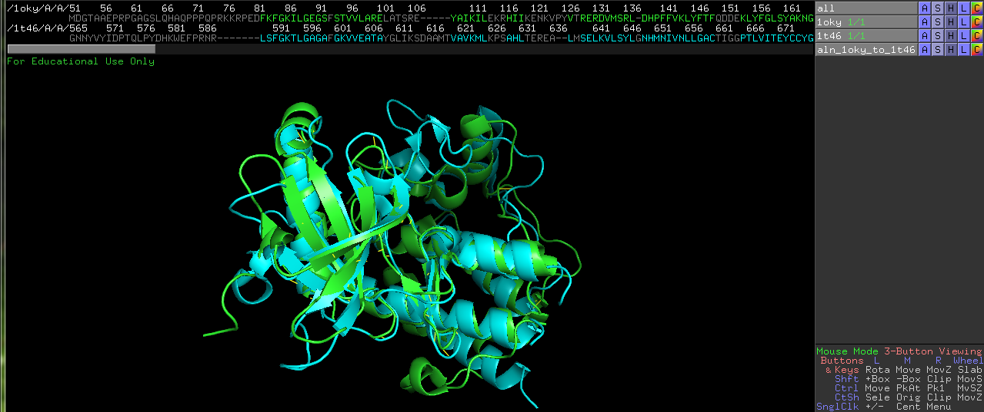
Align two structures
Choose one of the molecules: Actions-> Align -> To molecule (the other one)
Command: align pdb1, pdb2, objectname
Saving the aligned sequences in clustalw format: save file.aln, objectname
or File -> save alignment

Slide 13
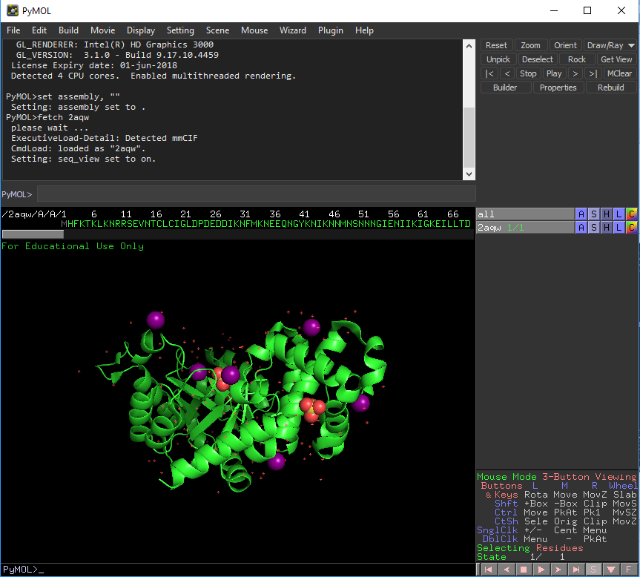
Selections
Command line: select name, (selection)
From sequence viewer: highlight the wanted sequence
Picking a residue / molecule / atom: click an atom. Use the representations to show atoms. Toggle selecting options in the movie control.

Slide 14
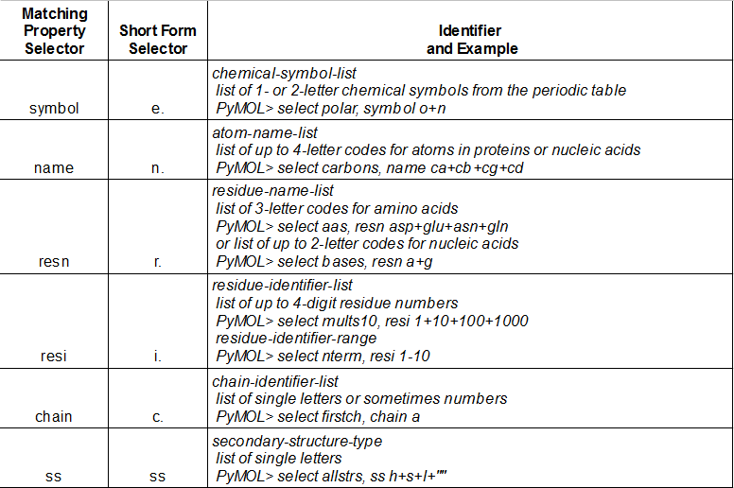
Command line selections

Slide 15
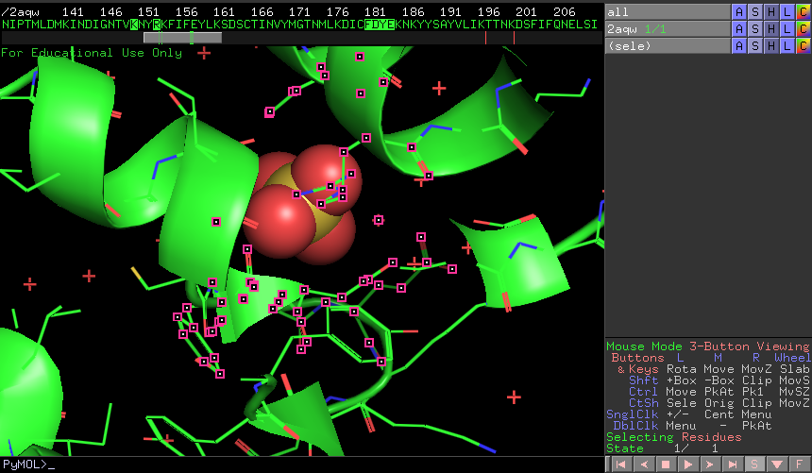
Expand selection

Slide 16
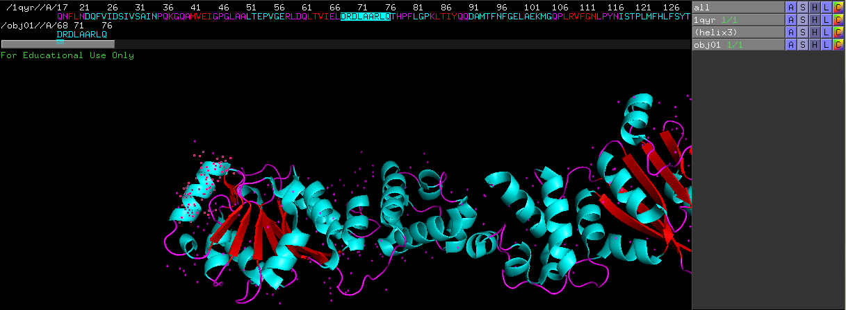
Objects
What is the difference between a selection and an object?
Selection named “helix3”
Object named “obj01”

Slide 17
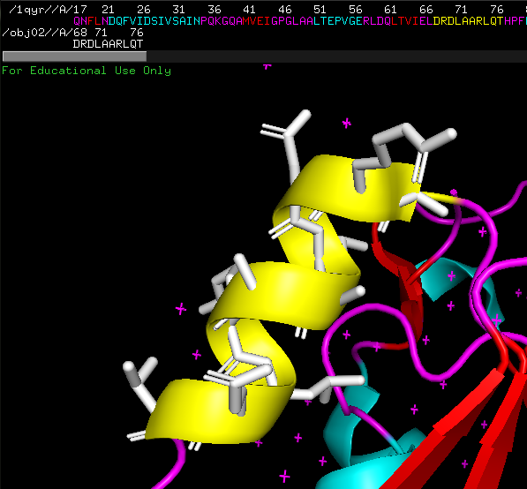
Working with objects
Example:
The selected helix is presented as yellow cartoons.
The object is shown as white sticks (cartoon is hidden).

Slide 18
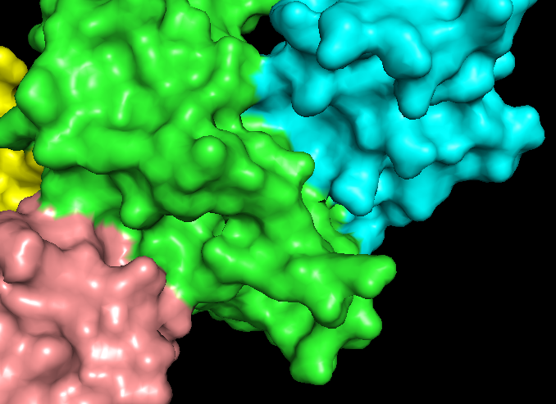
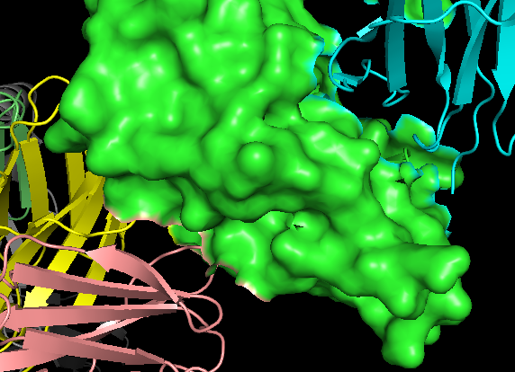
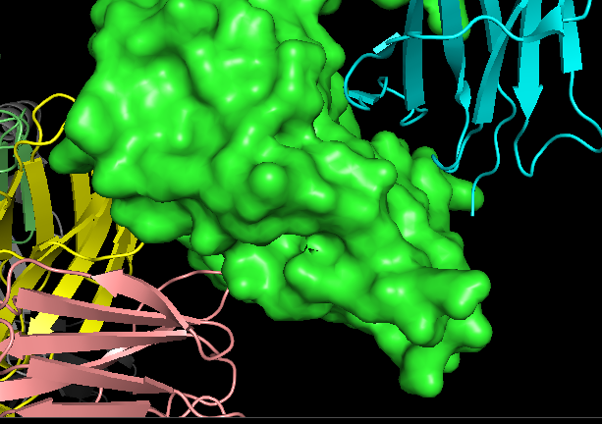
Surfaces of multiple chains
surface of a selected chain copied to a new object
Surface of all chains together
surface of one selected chain

Slide 19
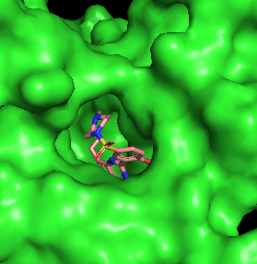
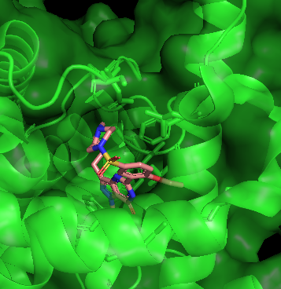
Transparency
Settings->transparency
Example: show a protein by surface and its ligand by sticks. Then set transparency of the surface to 50%, add cartoon representation to the protein and modify ligand selection to include residues 4 angstroms around it.

Slide 20
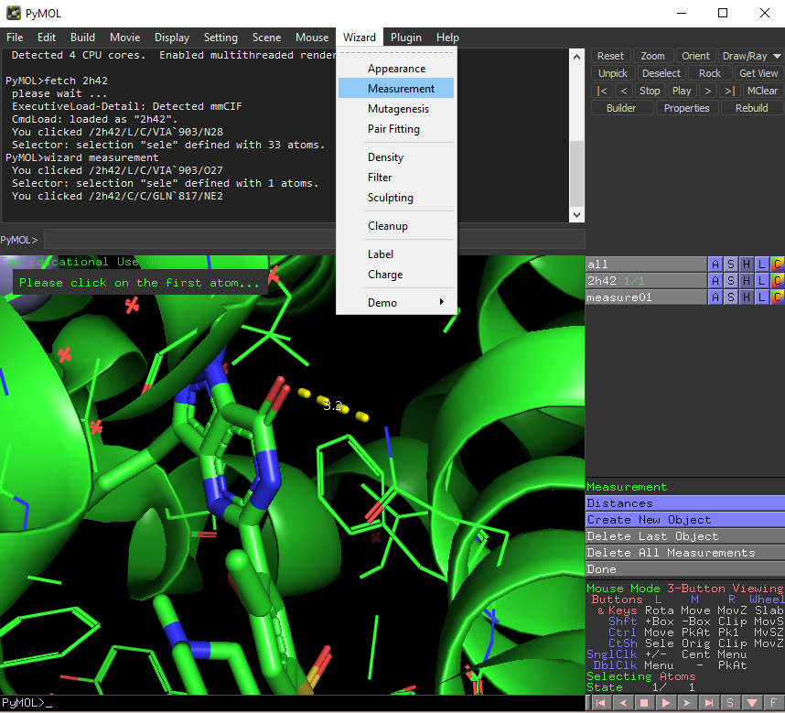
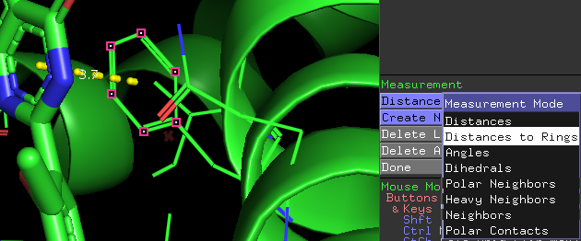
Measurements
First, present the wanted residues as sticks or wires.
Wizard -> Measurements
Click on two atoms.
Change measurements mode:

Slide 21
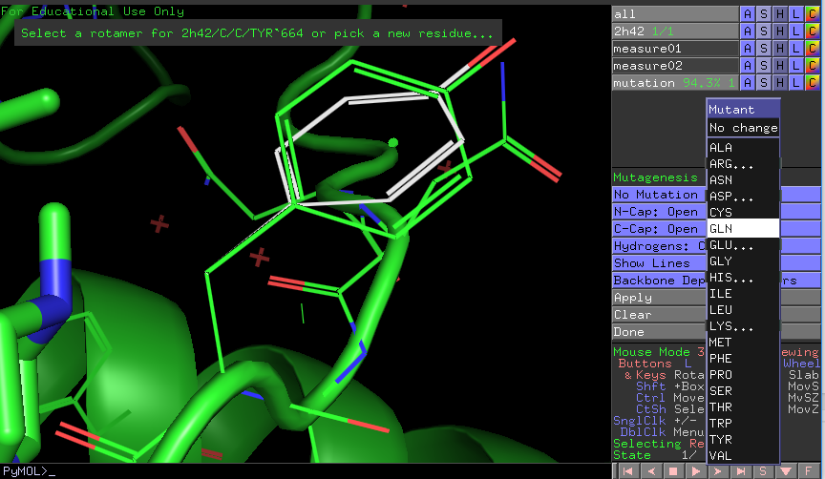
Point Mutations
Preent the wanted amino acid in sticks or wires
Wizards-> Mutagenesis
Pick a residue
Change “no mutation” to the wanted amino acid
Apply
File->export molecule

Slide 22
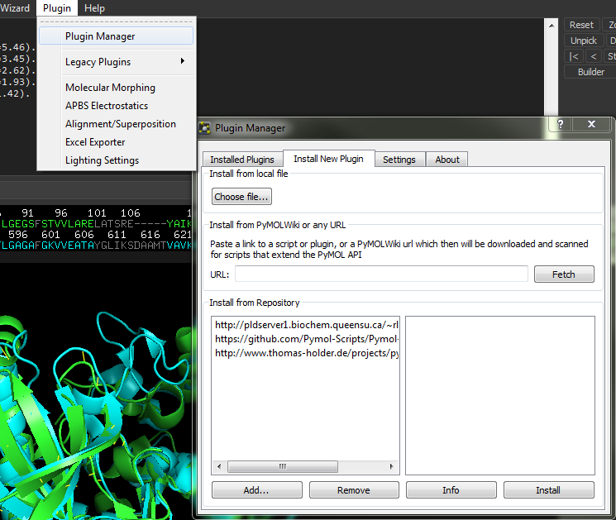
Plugins

Slide 23
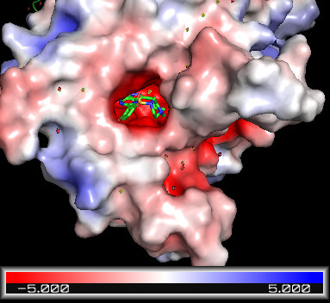
Electrostatic Potential
Plugins -> APBS electrostatics
See differences between calculating for all chains vs. single selected chain

Slide 24
Making Movies
Fetch 1hpv
Action->Preset->Technical (on the object in the viewer gui)
Scene->Store->F1
Type zoom i. 200 to zoom on the ligand
Scene->Store->F2
Movie->Program->Scene Loop->Y-Rock->4 Seconds Each
Done! Press play.
More examples:https://pymolwiki.org/index.php/MovieSchool

Slide 25
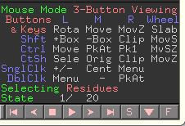
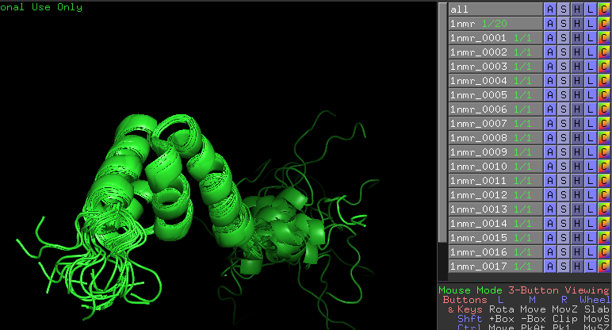
NMR structures
Example: fetch 1nmr
Move between states using the movie control.
Command: split_states 1nmr

Slide 26
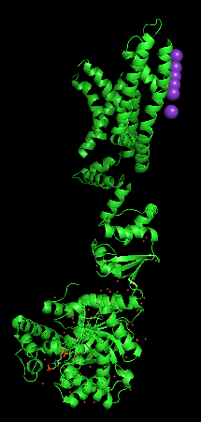
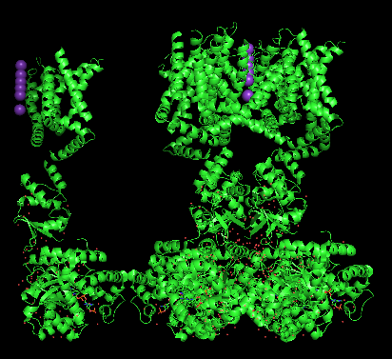
Reconstructing the crystal
Works only for x-ray structures, with known symmetry in the PDB file.
Actions ->generate -> symmetry mates
For example: PDB 2A79 appears as one chain (A). we can generate the tetramer using the crystal symmetry

Slide 27
PyMOL sessions
File -> Save Session (pse file)
Saves all representations, objects etc.
Useful before creating images

Slide 28
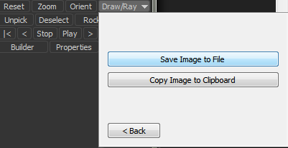
Saving Images
For better quality:
Change to higher DPI
Choose Ray(slow)

Slide 29
More help
https://pymolwiki.org/index.php/Main_Page
More commands
Python scripts
Plugins
Tutorials

